Slide 1
Bard BioSurgery
Innovative Hemostatic Solutions for Surgical Needs: Ramon E. Yera, MD
DAV/ARS/0815/0067

Slide 2
Disclaimers
The following presentation is made on behalf of Bard Davol Inc., and contains the opinions of, and personal surgical techniques practiced by Dr. Ramon Yera. Any discussion regarding Bard Davol products during the presentation is limited to information that is consistent with the FDA approvals or clearances for those products. The opinions and techniques presented herein are for informational purposes only and the decision of which techniques to use in a particular surgical application should be made by the surgeon based on the individual facts and circumstances of the patient and previous surgical experience.
Consult Bard Davol product labels and inserts for any indications, contraindications, hazards, warnings, precautions and instructions for use.
Dr. Yera is a paid consultant for Bard Davol.
DAV/ARS/0815/0067

Slide 3
Agenda
Bard BioSurgery A unique family of hemostatic solutions designed to meet your surgical needs.
Product Overview
ARISTA™ AH Absorbable Hemostatic Particles
Surgical Videos
DAV/ARS/0815/0067

Slide 4
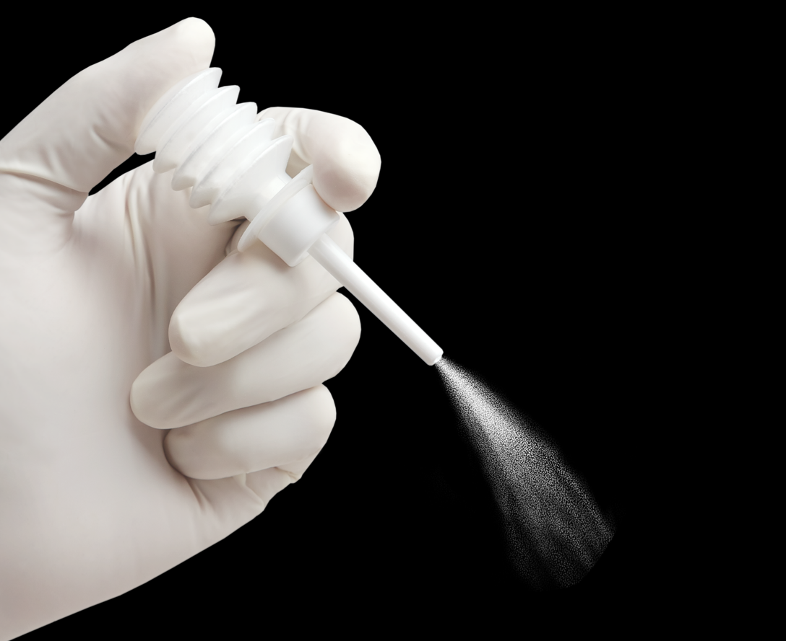
DAV/ARS/0815/0067

Slide 5
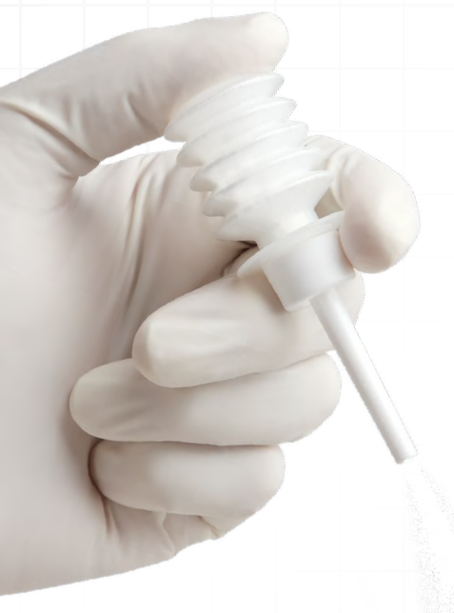
Arista™ Absorbable Hemostatic Particles
Simple. Safe. Effective
No mixing required
Typically absorbed and cleared by the body within 24-48 hours¹ by amylase enzymes
Thrombin-free; synthesized from a purified plant starch
Provides broad area coverage on rough surfaces and in hard-to- reach areas.
1 Because there have been reports of decreased amylase activity in newborns up to 10 months, absorption rates of Arista™AH in this population may be longer than 48 hours.
DAV/ARS/0815/0067

Slide 6
Arista™ Absorbable Hemostatic Particles
ARISTA™ AH is based on a technology platform of Microporous Polysaccharide Hemospheres (MPH), which is derived from a plant-based polymer material consisting of flowable microporous particles with extensive history of use in humans.
No animal or human blood, protein or tissue sources are utilized and it is thrombin free.
Microporous particles are designed to act as molecular sieves. The powerful osmotic action dehydrates and gels the blood on contact to accelerate the natural clotting process.
MPH particles concentrate blood solids such as platelets, red blood cells and blood proteins to form a gelled matrix, providing a barrier to further blood loss.
Nominal size of 60 microns.
DAV/ARS/0815/0067

Slide 7
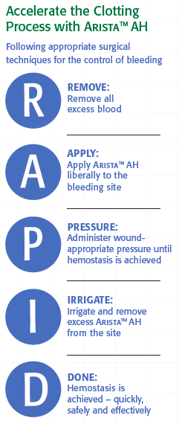
Arista™ Absorbable Hemostatic Particles
Proven Safety and Efficacy in a Variety of Surgical Areas and Procedure Types
Examples include:
Cardiothoracic and Cardiovascular
Vascular
Gynecological
Urology
General Surgery
Plastic Surgery
ENT Surgery
Use of Arista™ AH in neurological or ophthalmic surgical procedures is excluded from its approved indication.
DAV/ARS/0815/0067

Slide 8
Surgical Videos
DAV/ARS/0815/0067

Slide 9
Arista™ Absorbable Hemostatic Particles
INTENDED USE / INDICATIONS FOR USE
ARISTA™ AH is indicated in surgical procedures (except neurological and ophthalmic) as an adjunctive hemostatic device to assist when control of capillary, venous, and arteriolar bleeding by pressure, ligature, and other conventional procedures is ineffective or impractical.
Contraindications
Do not inject or place ARISTA™ AH into blood vessels as potential for embolization and death may exist.
Warnings
ARISTA™ AH is not intended as a substitute for meticulous surgical technique and the proper application of ligatures or other conventional procedures for hemostasis. Once hemostasis is achieved, excess ARISTA™ AH should be removed from the site of application by irrigation and aspiration particularly when used in and around foramina of bone, areas of bony confine, the spinal cord, and/or the optic nerve and chiasm. ARISTA™ AH swells to its maximum volume immediately upon contact with blood or other fluids. Dry, white ARISTA™ AH should be removed. The possibility of the product interfering with normal function and/or causing compression necrosis of surrounding tissues due to swelling is reduced by removal of excess dry material. Safety and effectiveness of ARISTA™ AH have not been clinically evaluated in children and pregnant women. Because there have been reports of decreased amylase activity in newborns up to 10 months, absorption rates of ARISTA™ AH in this population may be longer than 48 hours.
ARISTA™ AH should be used with caution in the presence of infection or in contaminated areas of the body. If signs of infection or abscess develop where ARISTA™ AH has been applied, re-operation may be necessary in order to allow drainage. Safety and effectiveness in neurosurgical and ophthalmic procedures has not been established.
ARISTA™ AH should not be used for controlling post-partum bleeding or menorrhagia.
DAV/ARS/0815/0067

Slide 10
Arista™ Absorbable Hemostatic Particles
PRECAUTIONS
When ARISTA™ AH is used in conjunction with autologous blood salvage circuits, carefully follow instructions in the Administration section of the IFU regarding proper filtration and cell washing. ARISTA™ AH is intended to be used in a dry state. Contact with saline or antibiotic solutions prior to achieving hemostasis will result in loss of hemostatic potential. ARISTA™ AH is not recommended for the primary treatment of coagulation disorders. No testing has been performed on the use of ARISTA™ AH on bone surfaces to which prosthetic materials are to be attached with adhesives and is therefore not recommended. ARISTA™ AH is supplied as a sterile product and cannot be resterilized. Unused, open containers of ARISTA™ AH should be discarded. Do not apply more than 50g of ARISTA™ AH in diabetic patients as it has been calculated that amounts in excess of 50g could affect the glucose load. In urological procedures, ARISTA™ AH should not be left in the renal pelvis or ureters to eliminate the potential foci for calculus formation.
Adverse Reactions
None of the adverse events that occurred in a randomized prospective, concurrently controlled clinical trial were judged by the Data Safety Monitoring Board to be related to the use of ARISTA™ AH. The most common recorded adverse events were pain related to surgery, anemia, nausea, lab values out of normal range, arrhythmia, constipation, respiratory dysfunction and hypotension – all reported in greater than 10% of the ARISTA™ AH treated patients. The details of this clinical trial’s adverse events can be reviewed in the IFU supplied with the product and are also available at www.davol.com.
Caution: Federal (USA) law restricts this device to sale by or on order of a licensed physician or properly licensed practitioner.
DAV/ARS/0815/0067

